Slide 1
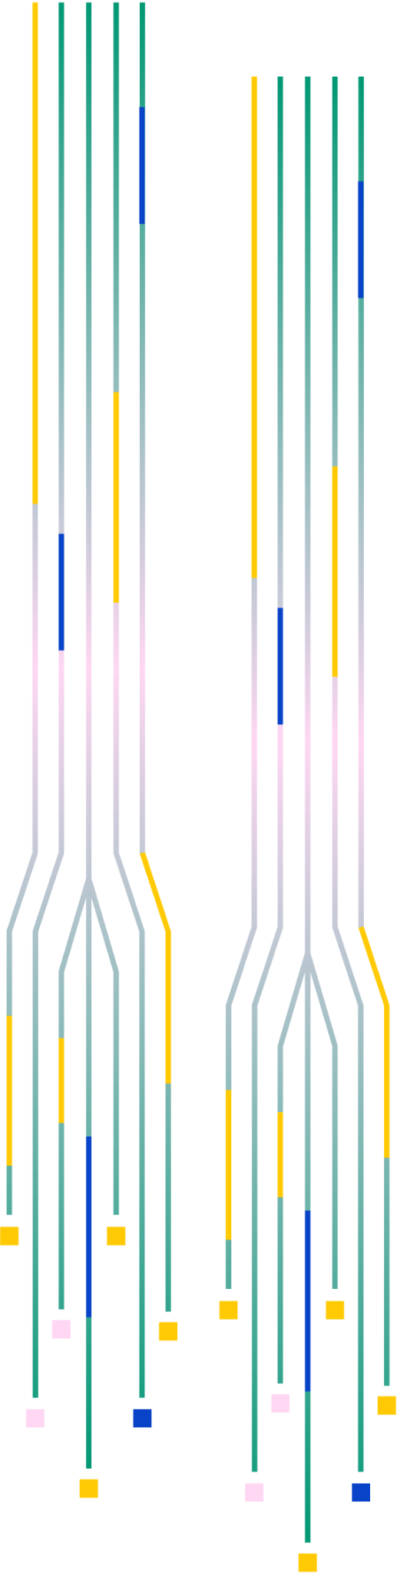



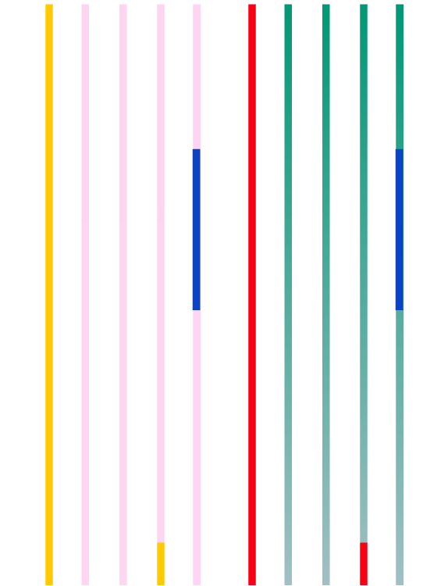
Sai Yadavalli | Srihas Surapaneni | Dr. Browning
COMPUTATIONAL MODELING
WEEK 2 (02/20/2024)

Slide 2




AGENDA
01
02
03
04
Class Overview Recap
Python Review
Intro to Classical Dynamics
Homework

Slide 3
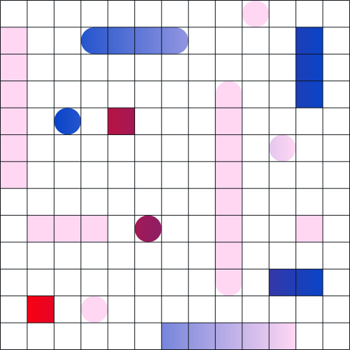


Today

Slide 4

Task
Problem
Input
Initial velocity (v) in meters per second.
Launch angle (θ) in degrees relative to the horizontal.
Constant: Acceleration due to gravity (9.8 m/s²
You are tasked with creating a computational model to predict where a ball will land when thrown at a certain angle and velocity. Assume the ball is thrown on a flat, frictionless surface, neglecting air resistance.
Output
Horizontal distance traveled by ball in (d) meters.

Slide 5




What You Need to Do?
Assume
Do
Implement the computational model using a programming language of your choice.
Validate the model by comparing its predictions with known solutions or empirical data.
Test the model with various combinations of initial velocities and launch angles.
Visualize the trajectory of the ball (optional, and will focus more on in next class).
Discuss the limitations of the model and potential improvements.
The ball is thrown from ground level.
The impact of air resistance is ignored.
The gravitational force is constant and acts downward throughout the motion.
The surface is frictionless.

Slide 6




How we may DO this?

Slide 7


Logic
Step 1
Break down the initial velocity into its horizontal (v_x) and vertical (v_y) components:
A
Step 2
Calculate the time taken for the ball to reach maximum height (t_{max}).
​
Problem
Step 3
Calculate the maximum height reached (h_{max})
B
Step 4
Calculate the total time of flight (t_{flight})
​
Finally, with all this, you can calculate the horizontal distance traveled (d)

Slide 8


STEP-BY-STEP CODING
01
02
03
04
Equation 1
Equation 2
Equation 03
Equation 4
Vx = v * cos(θ)
Vy = v * sin(θ)
_{Vvx = v *cos}
Tmax = Vy/g
hmax= v²y/2g
Tflight = 2 * tmax

Slide 9

Final Equation and Answer
05
Equation 05
d = Vx * Tflight
06
Output
“The ball traveled {d} and {hmax} high”
Topic 02

Slide 10

Questions?

Slide 11

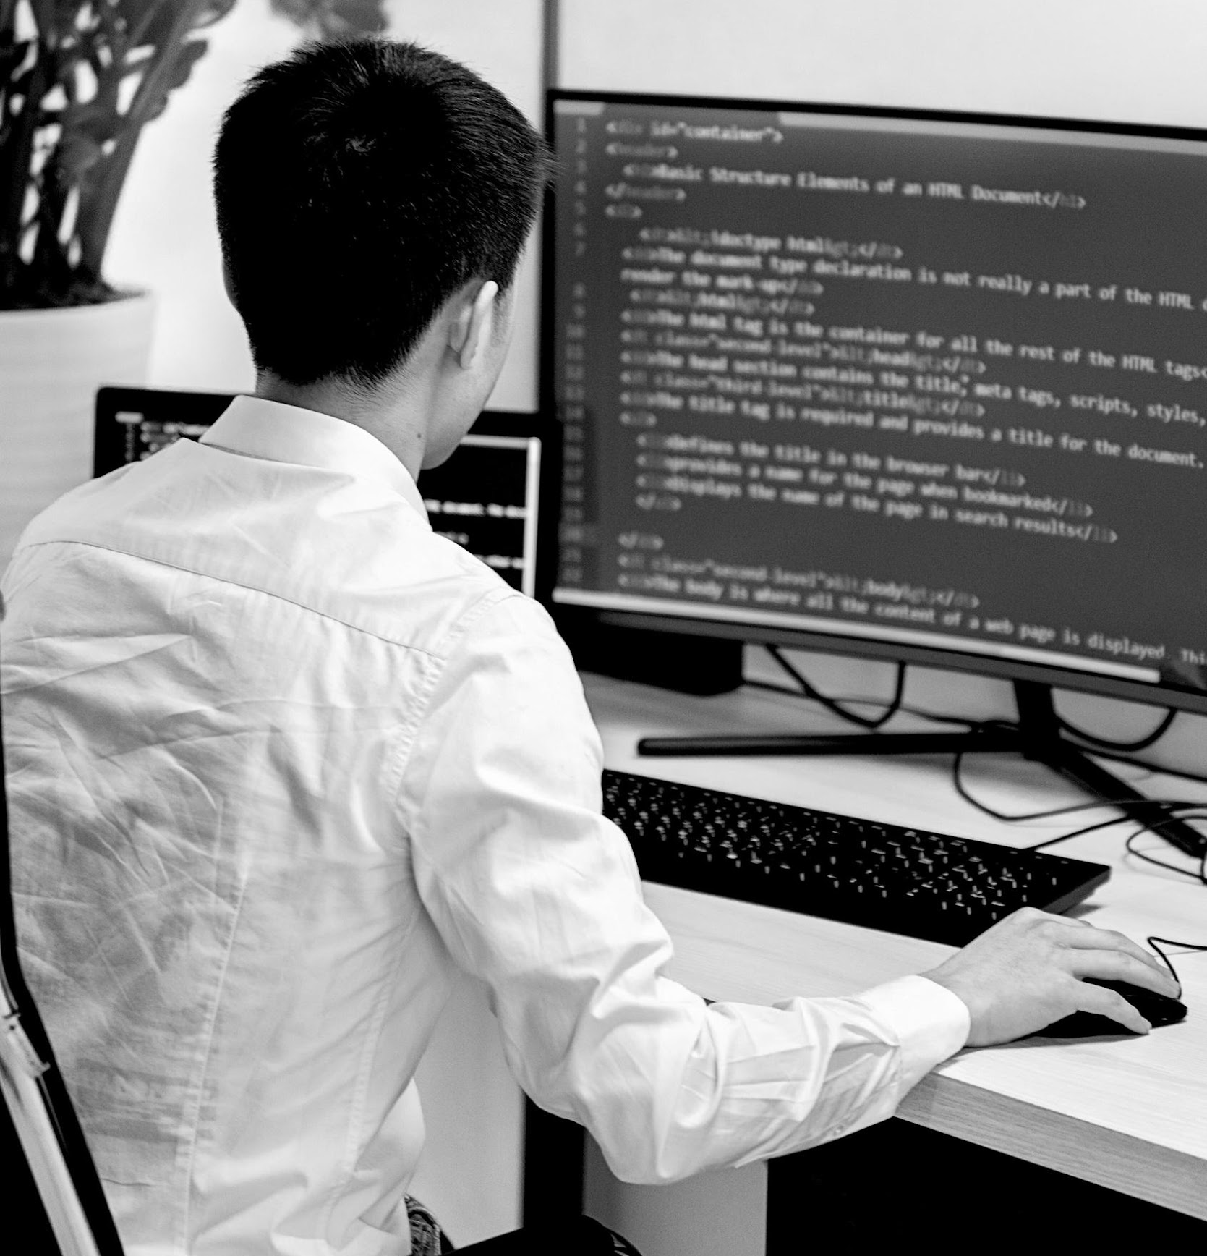
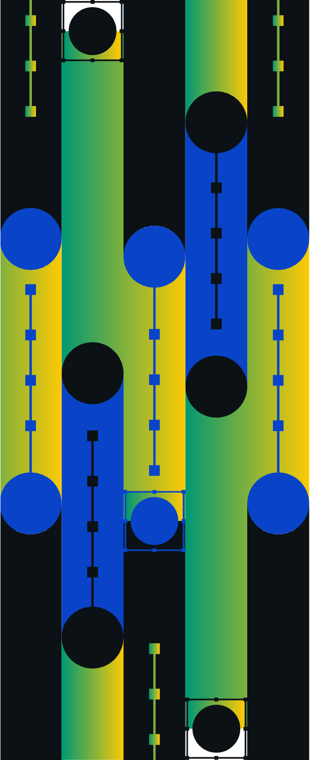
THANK YOU

Slide 12
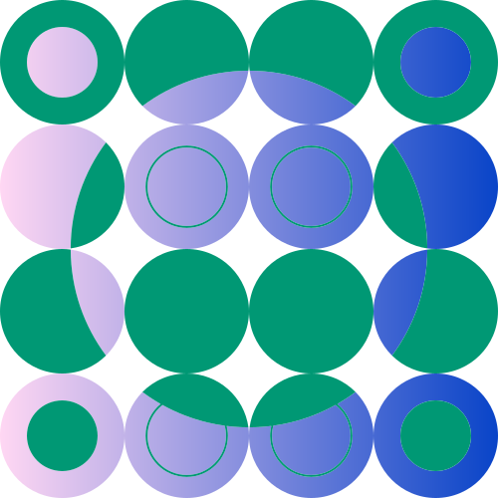


CREDITS
This presentation template is free for everyone to use thanks to the following:
SLIDESCARNIVAL
for the presentation template
PEXELS
for the photos

